Slide 1
A Movie Recommendation program
GroupLens Research makes available several datasets of movie ratings by users of their MovieLens website. See: http://grouplens.org/datasets/movielens/
This data consists of:
User profiles
Movie descriptions
Ratings (lots)
We’ll use this data to recommend movies similar to each other. So, you can make a recommendation like “if you liked this movie, here are the others you might like”.
The basic idea is: we look at every case where a user has rated the specified movie, and look at the other movies he has rated. We select for other movies that are typically given about the same rating as the specified movie. (We don’t care whether they rate the movie good or bad, just that the ratings are the same.)

Slide 2
datasets
To develop and test the code locally, we’ll use the MovieLens 100K Dataset, featuring 100,000 ratings from 1000 users on 1700 movies.
Then we’ll scale up to an Amazon Web Services cluster to analyze the MovieLens 10M dataset, featuring 1 million ratings from 6000 users on 4000 movies.
Download the datasets from: http://grouplens.org/datasets/movielens/

Slide 3
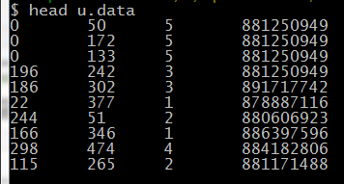
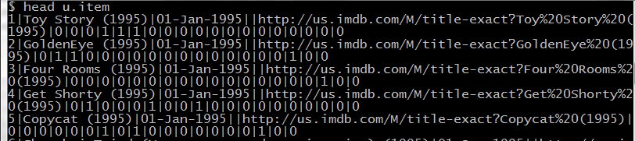
Movielens 100k
We’ll need two files: u.data which contains the ratings, and u.item which gives the movie information. We’ll only use u.item to look up the real names of the movies; most of our code works on the ratings data.
The corresponding files in the MovieLens 1M dataset are ratings.dat and movies.dat

Slide 4
The plan (in a nutshell)
Read the data and map it to (user, (movie,rating))
Self-join for each user to get all combinations of movie ratings by the user: (user, ((movie,rating),(movie,rating))
Every user rated at least 20 movies, so this blows up the data to huge scale
Remove duplicates from the self-join
Key by every combination of movies that were rated together: ((movie1,movie2),(rating1,rating2))
Group pairs of ratings by pairs of movies: ((m1,m2),((r1,r2),(r1,r2),…,(r1,r2)))
Calculate statistical similarity for each pair: ((m1,m2),(score,numPairs))
Filter and sort the top ten similarities to a movie requested by the user.

Slide 5
Read the data

Slide 6
Self-join
This self-join is a Cartesian product, so it blows up very quickly. If a user has rated three movies, those three rows of the “ratings” RDD will become nine rows of the “joinedRatings” RDD. This is the biggest limit on the performance of our algorithm.
(user1, (movie1,rating1), (movie1,rating1))
(user1, (movie1,rating1), (movie2,rating2))
(user1, (movie1,rating1), (movie3,rating3))
(user1, (movie2,rating2), (movie1,rating1))
(user1, (movie2,rating2), (movie2,rating2))
(user1, (movie2,rating2), (movie3,rating3))
(user1, (movie3,rating3), (movie1,rating1))
(user1, (movie3,rating3), (movie2,rating2))
(user1, (movie3,rating3), (movie3,rating3))
(user1, (movie1,rating1))
(user1, (movie2,rating2))
(user1, (movie3,rating3))
But in this dataset, every user has rated at least 20 movies!

Slide 7
Remove duplicates
You might have the same two movies joined in both orders, or a movie joined to itself, for example:
(user, ((100,5),(200,4)))
(user, ((200,4),(100,5)))
(user, ((100,5),(100,5)))
(user, ((200,4),(200,4)))
Remove duplicates by filtering for the condition where movie1 < movie2:

Slide 8


Re-key by movie pair
Re-organize the data as K-V pairs where the pair of two movies is the key, and pair of ratings is the value:

Slide 9
Now group all ratings pairs for each movie pair
The result is that for every combination of movies, we now have a grouped dataset of ratings by different users. We can analyze this data statistically, for example by computing the correlation, to “score” each pair of movies. EG:
( (movie1,movie2), ((rating1,rating2),(rating1,rating2),…,(rating1,rating2),…) )

Slide 10
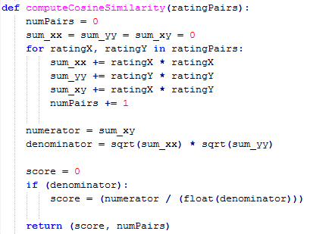

Finally, compute similarities (and cache in memory)
I’m using a cosine similarity statistic in this example. You could use something else, like a Pearson correlation, to see if you get different results!

Slide 11

To find the desired result, first set some standards of quality for “good” matches
We only want similarities for movies that were rated together at least 50 times. If two movies have only been rated by the same people a few times, we don’t think the data is reliable.
Also, we don’t want to return results that aren’t very similar, so we set a minimum score of 0.97 to identify good matches.
You can alter these to try to improve your code.

Slide 12
Now, get the user’s requested movie# and filter the results

Slide 13
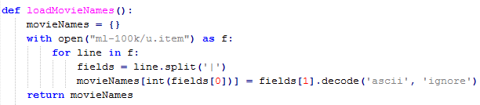

Generate a “namedict” mapping movie# to Movie Name

Slide 14
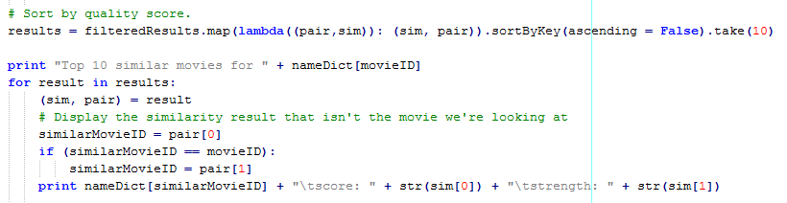
Sort by score, take the top 10, and print
Using nameDict, we can print the true name of the movie instead of the ID #.

Slide 15
Run the code
To run this in the Cloudera VM, you’ll need to first download the data:
http://grouplens.org/datasets/movielens/
Unzip the ml-100k.zip and drag the “ml-100k” folder into your home directory. The code expects the files to be found in /home/cloudera/ml-100k/, so you’ll have to change the code if you store the data elsewhere.
The number “50” is for the original “Star Wars”; you may choose a different movie if you like

Slide 16
Y
X(r1m1, r2m1)
Y
Y
X(5, 4)
θXY
Y(r1m2, r2m2)
X(5, 1)
θXY
Y(1.5,0)
θXY
Y(4.5,0)
X
X
X
Vector representation of cosine similarity logic
Figure Not drawn to scale
Vector representation of case (iv)
Figure Not drawn to scale
Vector representation of case (vi)
Figure Not drawn to scale

